Slide 1
TOPIC
Impact of Denoising Retinal OCT Images in Classification
PRESENTED BY
(GROUP- 14)
Student ID
1502216
1602266
1602273
Name
Md. Habibur Rahman
Md. Ahnaf Hossain
Md. Shikhar Ali
SUPERVISOR
Md. Ferdous Wahid
Assistant Professor
Department of Electrical and Electronic Engineering
Hajee Mohammad Danesh Science and technology University,
Dinajpur 5200
CO-SUPERVISOR
Md. Safiqul Islam
Assistant Professor
Department of Electrical and Electronic Engineering
Hajee Mohammad Danesh Science and technology University, Dinajpur- 5200

Slide 2
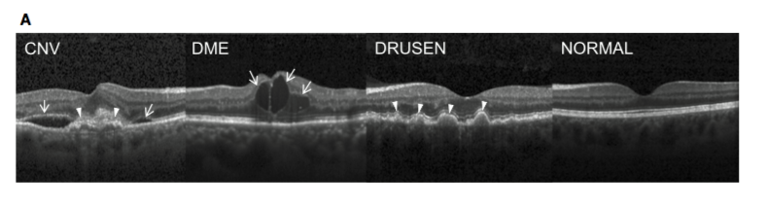
Introduction
In this paper the main motive is to coming up with the impact of denoising Optical Coherence Tomography (OCT) Retinal images via showing accuracy rate difference between classification with noisy images and denoised images. Retinal OCT images are always noisy. Even in better cases, it’s hard to find a single image without any noise. Image classification is used for classify among different types of that same category. Block Matching 3D (BM3D) is the denoising algorithm which will be used for preparing denoised dataset with the help of Sk-image (scikit-image) and OpenCV. For classification, Convolutional Neural Networks (CNN), specifically Inception V3 network is used on the both data sets (Noisy Images Data set and Denoised Image Data set) with Python and the Keras deep learning library. In data sets, they are prepared with Drusen and Normal Images. Applying classification models over those data sets, a clear concept will come out as the impact of denoising retinal OCT images in classification.

Slide 3
Literature Review
Recent research has focused on automatically classifying OCT images by extracting image attributes and using classification or segmentation algorithms. To reduce image noise and size, Discrete Wavelength Transformation (DWT) is applied. Three classifiers are used: Probabilistic Neural Network (PNN), Bayes Classifier and Support Vector Classifier (SVM). For the SVM classifier, the best scores for specificity, sensitivity, and accuracy are 96, 98, and 97.6, respectively. 28.6% of the data set is used as the training set, and the remaining 72.4% is used for training. Training with more data can improve performance. The SVM classifier is used to assess the severity of the disease, regardless of whether the patient's eye exposure is moderate or severe. Ahmed El Tanboli et al. developed a DR detection system that uses three-stage OCT images and uses various segmentation and classification techniques. They extracted three main features from the segmented OCT image to quantify the following: "reflectivity", "curvature" and "thickness" of the retinal layer. The feature of the segmented layer is a function that describes the random distribution of the extracted features, which is called the cumulative probability distribution function (CDF). The classifier used is trained to select the characteristics of the retinal layer and use its CDF to identify DR. The sensitivity, accuracy and specificity of the system are 83%, 92% and 100%, respectively.

Slide 4
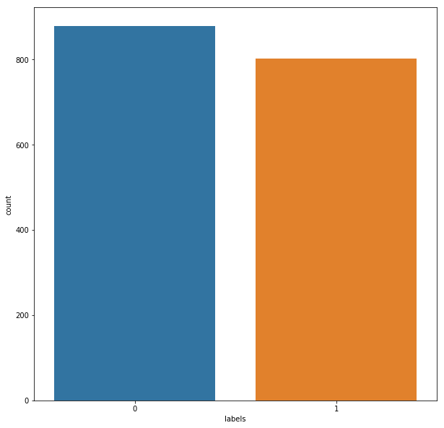
Dataset Preparation
For determining the impact of denoising OCT images in classification we need to prepare two different datasets. One is with noisy images and the other one is with denoised images. They will be prepared based on two categories of images. They are – Drusen and Normal Category.
Noisy Image Dataset: A noisy image dataset is prepared with 2100 images of Drusen and Normal Category. They images were collected from Kaggle. After downloading the dataset from Kaggle, we prepared a new data set from those images. We didn’t take those images randomly. The quality, shape and size were considered as the basic requirements for selected those images.
Denoised Image Dataset: This dataset is prepared with the same images which were used for the noisy image dataset. For denoising the images there are several denoising algorithms. Like- Gaussian Filter, Non-Local Means filter, Anisotropic Diffusion Filter etc. But we’ve chosen Block Matching 3D AKA, BM3D filter for denoising the noisy images. Among the other denoising algorithms, BM3D shows the most details than the others that’s why we choose that.

Slide 5
Methodology
Noises in OCT Images:
Amplifier noise (Gaussian noise): The standard model of amplifier noise is additive, Gaussian, independent at each pixel and independent of the signal intensity.
Salt-and-pepper noise: An image containing salt-and-pepper noise will have dark pixels in bright regions and bright pixels in dark regions.
Poisson noise: Poisson noise or shot noise is a type of electronic noise that occurs when the finite number of particles that carry energy, such as electrons in an electronic circuit or photons in an optical device, is small enough to give rise to detectable statistical fluctuations in a measurement.
Speckle noise: Speckle noise is a granular noise that inherently exists in and degrades the quality of the active radar and synthetic aperture radar (SAR) images. Speckle noise in conventional radar results from random fluctuations in the return signal from an object that is no bigger than a single image-processing element.

Slide 6
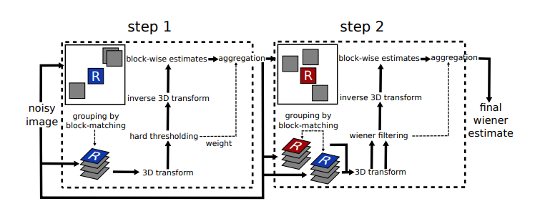
Image Denoising with Block Matching 3D
Arguments:
• include top: Boolean, whether to include the fully-connected layer at the top, as the last layer of the network. Default to True.
• weights: One of None (random initialization), ImageNet (pre-training on ImageNet), or the path to the weights file to be loaded. Default to ImageNet.
Input tensor: Optional Keras tensor to use as image input.
Input shape: Optional shape tuple, only be specified if include top is false.
Pooling: Optional pooling mode for feature extraction when include top is false
Classes: optional number of classes to classify images into, only to be specified if include top is True, and if no weights argument is specified. Default to 1000.

Slide 7
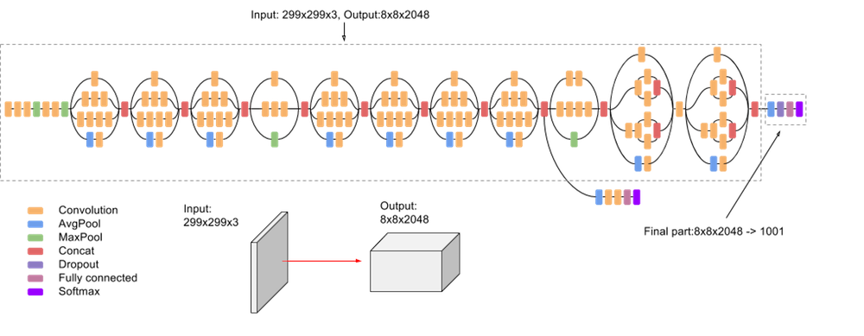
Classification with Inception V3 Convolutional Network:
Inception v3 is a widely-used image recognition model that has been shown to attain greater than 78.1% accuracy on the ImageNet dataset. The model is the culmination of many ideas developed by multiple researchers over the years. It is based on the original paper: "Rethinking the Inception Architecture for Computer Vision" by Szegedy, et. al. The model itself is made up of symmetric and asymmetric building blocks, including convolutions, average pooling, max pooling, concats, dropouts, and fully connected layers. Batchnorm is used extensively throughout the model and applied to activation inputs. Loss is computed via Softmax. A high-level diagram of the model is shown below:

Slide 8
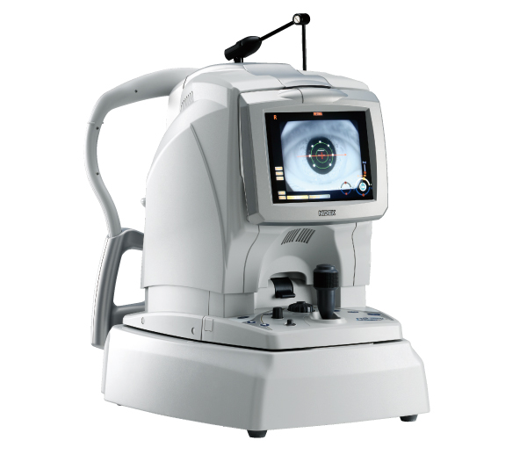
Experimental Setup
Hardware Requirement:
For capturing the OCT images, we need to use a hardware named OCT Machine/Optical Coherence Tomography Machine.
Software Requirement:
This whole process is mainly based on the Software works. After getting the images from the OCT Machine, it’s all about the software works.
Some basic requirements are given below:
Anaconda Environment
Python
OpenCV
Scikit image
Jupyter Notebook (Kaggle Karnel)

Slide 9
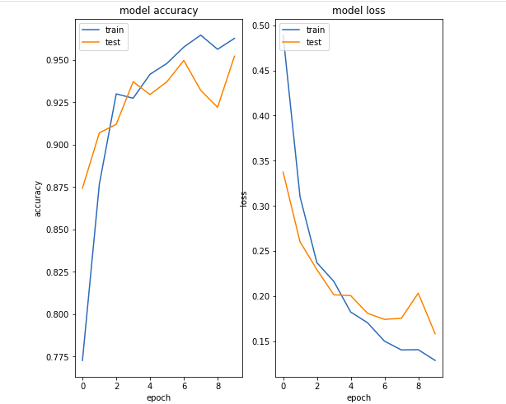
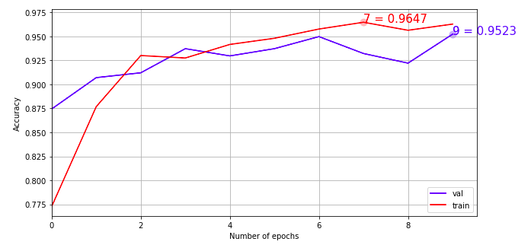
Result and Discussion
As this thesis is all about evaluating the impact of Denoising OCT images for classification,
there is going to be two repeated process:
1. Classification with noisy image dataset
2. Classification with denoised image dataset
Classification with Noisy Image Dataset:
In this step after completing the testing, we got the accuracy of 95.226%

Slide 10
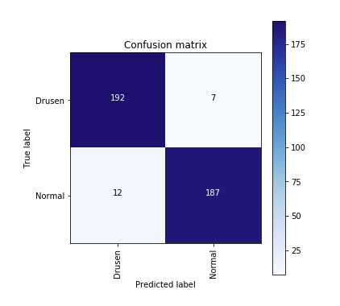
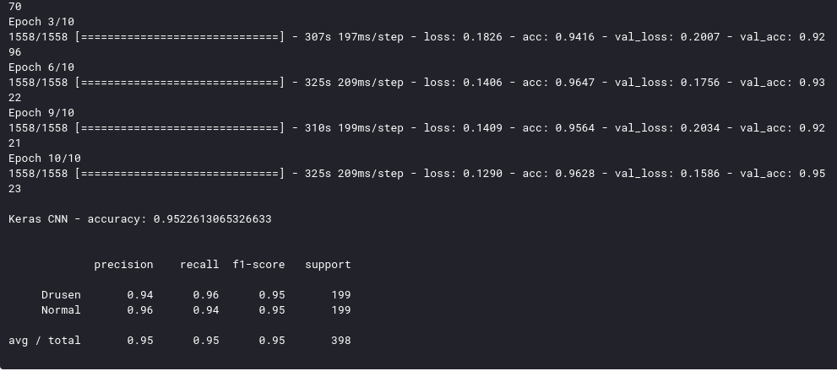

Slide 11
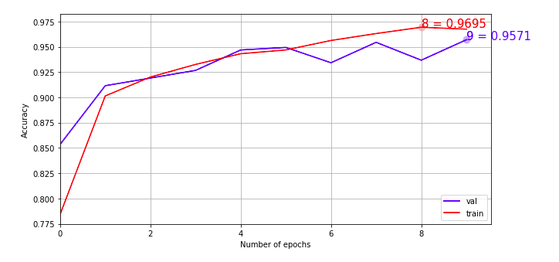
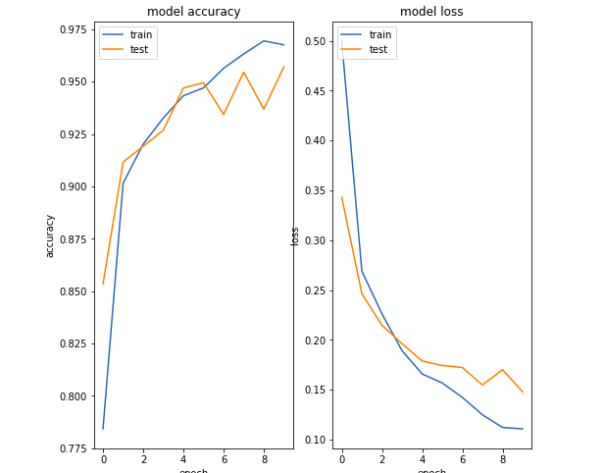
Classification with Denoised Image Dataset:
In this step after completing the testing, we got the accuracy of 95.70%

Slide 12
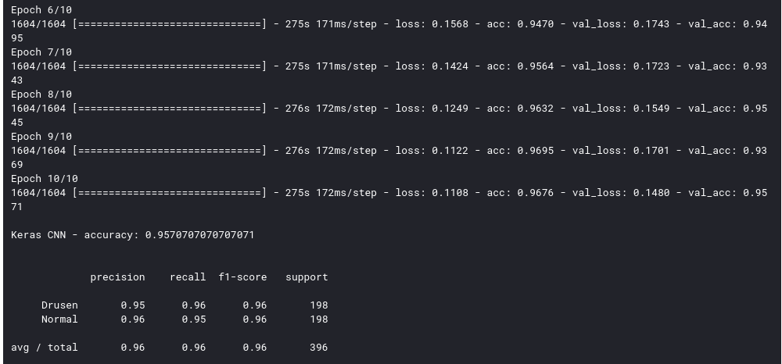
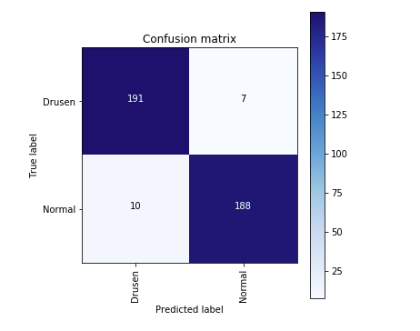
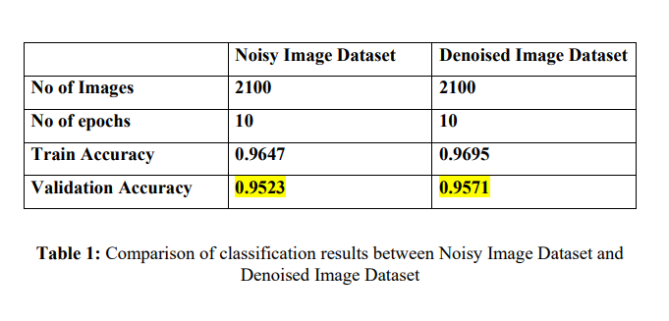

Slide 13
Conclusion
From the Result and Discussion Chapter we’ve got a clear overview of what can be the impact of Denoising OCT images in terms of Classifying the images.
We’ve seen that in the first term, we did the classification with the noisy image dataset and we got the validation accuracy of 95.23% Then with the dataset of denoised images, we got the accuracy of 95.70% The number of images, number of epochs, test-train split ratio everything were same but for the second step we used the Denoised version of the noisy image dataset which is giving almost 0.47% more accuracy

